Slide 1
Semi-Continuous Wildfire Modelling
Pedro Ferreira | António Capela

Slide 2
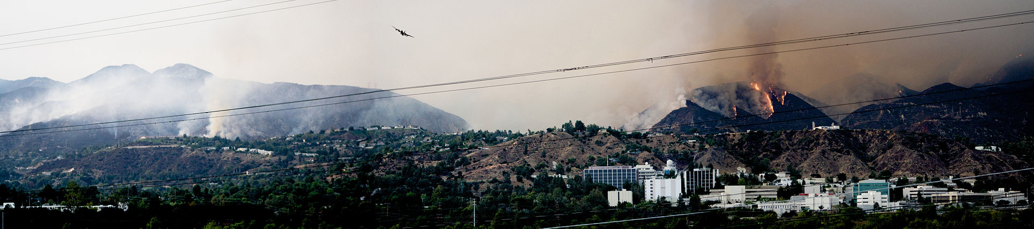
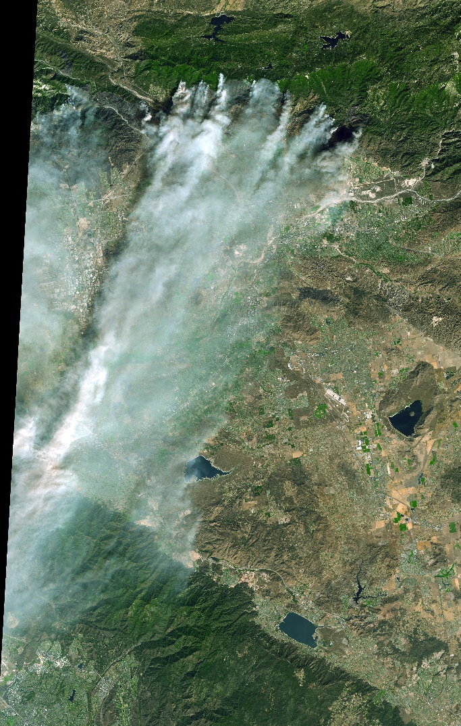
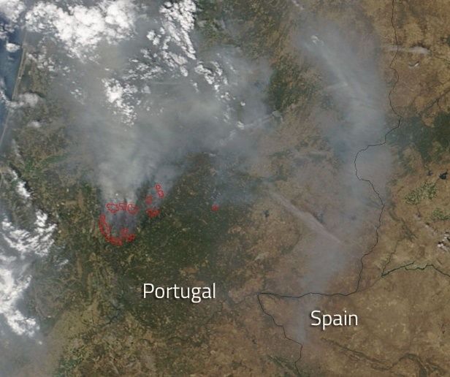
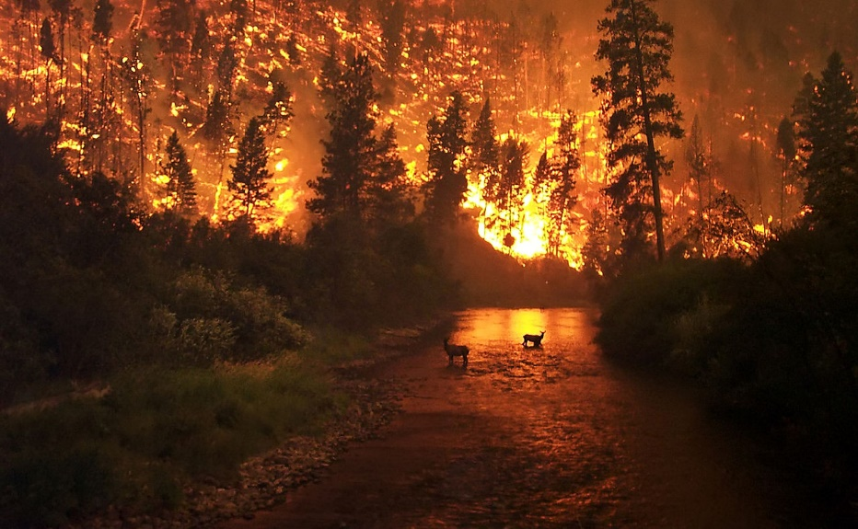
Wildfires as a potential hazard
2009 California Wildfires at NASA/JPL – Pasadena, California
2017 fires of Castanheira de Pêra and Pedrógão Grande - Portugal
Wildfire in Bitterroot National Forest - Montana
2003 Old Fire in the San Bernardino Mountains - Southern California

Slide 3
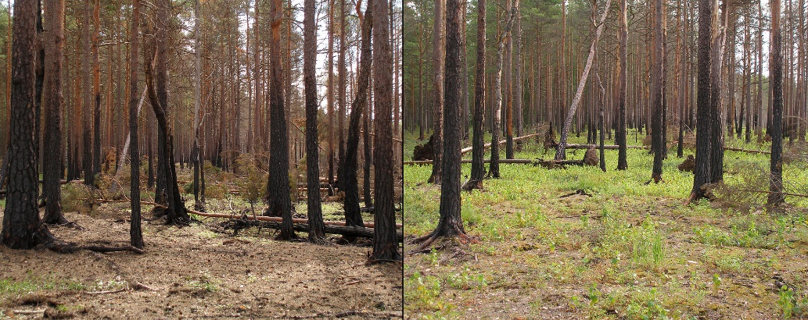
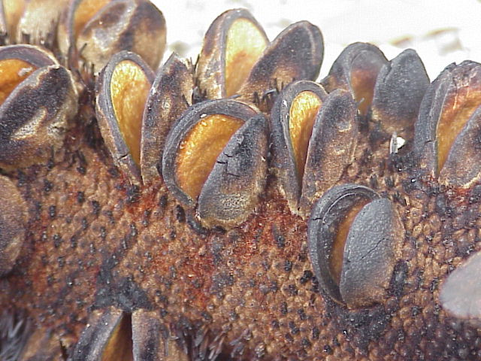

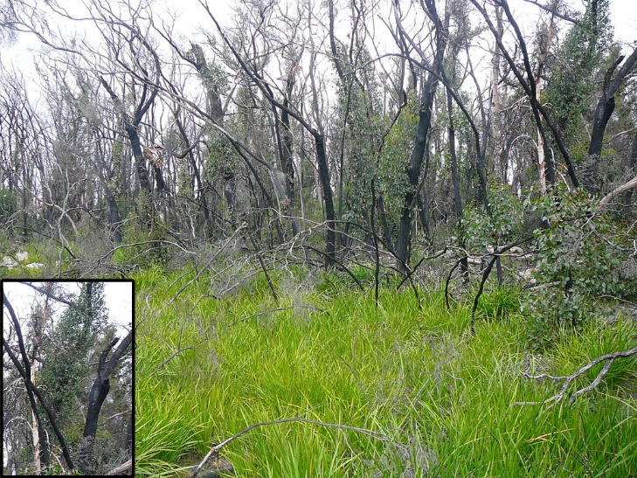
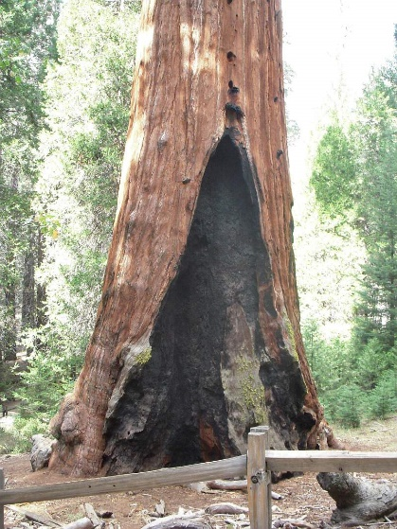
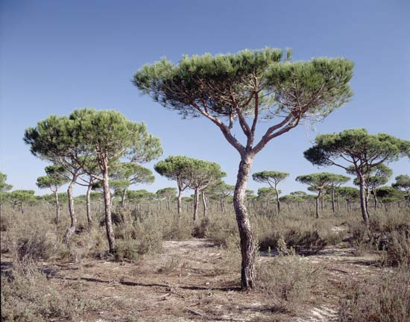
Wildfires as an ecological disturbance
Fire-activated seeds
Ecological succession
Prolific Flowering
Survival of the fire-resistant
Resprouting
Thermal Insulation
Tall Crowns

Slide 4
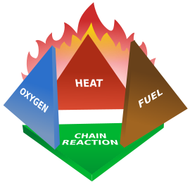
How fire burns
Ingredients:
Oxidizer (Usually oxygen)
Combustible material
Temperature above a critical temperature
If all three elements are present, combustion can occur and a positive feedback loop forms:
The fire tetrahedron
Fuel burns if temperature is high enough and there is enough oxygen -> Heat is produced -> Temperature increases
Temperature spreads to the surroundings, possibly igniting it as well.
This happens until there is no more fuel OR temperature drops below flash point OR there is no more oxygen.

Slide 5





The Heat Equation
Solve in 2D plane
$$ρc_{p}\frac{∂T}{∂t}− ∇⋅\left(k ∇T\right) ={\dot{q}}_{V}$$
$$\left(=\right)$$
$$\frac{∂T}{∂t}−α∇^{2}T=H$$
$$\left(=\right)$$
$$\frac{∂T}{∂t}\left(t,x,y\right)− α\left.\left(\frac{∂^{2}T}{∂x^{2}}\left(t,x,y\right)+\frac{∂^{2}T}{∂y^{2}}\left(t,x,y\right)\right.\right) = H\left(t,x,y\right)$$
Models Temperature Diffusion and Generation

Slide 6



Temperature Field
Temperature diffusion in the 2D plane
The heat equation then allows us to model how temperature spreads across the landscape, if we know how much heat the fire produces and where.
$$\frac{∂T}{∂t}\left(t,x,y\right)− α\left.\left(\frac{∂^{2}T}{∂x^{2}}\left(t,x,y\right)+\frac{∂^{2}T}{∂y^{2}}\left(t,x,y\right)\right.\right) = H\left(t,x,y\right)$$
$$\left(=\right)$$
$$T_{x,y}^{t+dt}= T_{x,y}^{t}+ dt\left.\left(α\left.\left( T_{x+dx,y}^{t}−2T_{x,y}^{t}+T_{x−dx,y}^{t}+ T_{x,y+dy}^{t}−2T_{x,y}^{t}+T_{x,y−dy}^{t}\right.\right)+ H_{x,y}^{t}\right.\right)$$
For now, let’s continue to understand how temperature might behave and return to the heat later.
T-Field

Slide 7


Temperature Field
Temperature Loss to the Atmosphere
Assumed exponential decay, as if there was an atmospheric diffusion: T lost proportional to T.
$$T_{x,y}^{t+dt}= T_{x,y}^{t}+ dt\left.\left(α\left.\left( T_{x+dx,y}^{t}−2T_{x,y}^{t}+T_{x−dx,y}^{t}+ T_{x,y+dy}^{t}−2T_{x,y}^{t}+T_{x,y−dy}^{t}\right.\right)+ H_{x,y}^{t}\right.\right)$$
$$T_{x,y}^{t+dt}= T_{x,y}^{t}+ dt\left.\left(α\left.\left( T_{x+dx,y}^{t}−2T_{x,y}^{t}+T_{x−dx,y}^{t}+ T_{x,y+dy}^{t}−2T_{x,y}^{t}+T_{x,y−dy}^{t}\right.\right)−α_{atm}T_{x,y}^{t}+ H_{x,y}^{t}\right.\right)$$
T-Field
$$α_{atm}$$

Slide 8

Wind Field
Wind Effects
Make T diffusion anisotropic, wildfire prefers the direction of the wind vector field W:
$$W_{x,y}^{t}=\left(u,v\right)$$
$$T_{x,y}^{t+dt}= T_{x,y}^{t}+ dt\left.\left(\begin{aligned}α\left.\left( T_{x+dx,y}^{t}\left(1−u\right)−2T_{x,y}^{t}+T_{x−dx,y}^{t}\left(1+u\right)+ T_{x,y+dy}^{t}\left(1−v\right)−2T_{x,y}^{t}+T_{x,y−dy}^{t}\right.\left(1+v\right)\right)− \\ −α_{atm}T_{x,y}^{t}+ H_{x,y}^{t}\end{aligned}\right.\right)$$
$$T_{x,y}^{t+dt}= T_{x,y}^{t}+ dt\left.\left(α\left.\left( T_{x+dx,y}^{t}−2T_{x,y}^{t}+T_{x−dx,y}^{t}+ T_{x,y+dy}^{t}−2T_{x,y}^{t}+T_{x,y−dy}^{t}\right.\right)−α_{atm}T_{x,y}^{t}+ H_{x,y}^{t}\right.\right)$$
W-Field
T-Field
$$α_{atm}$$

Slide 9

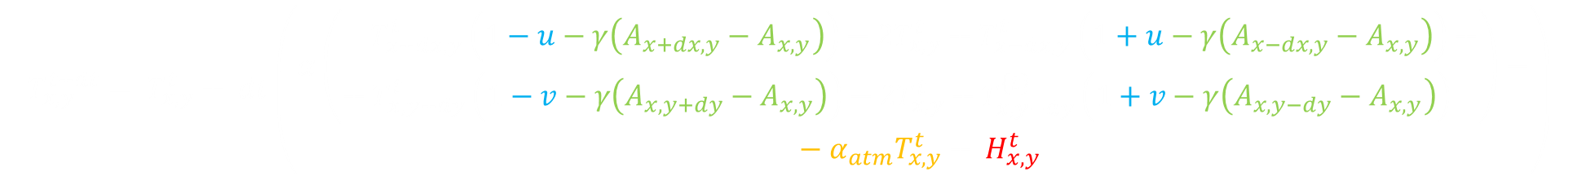
Altitude Effects
Altitude
Since hot air rises, wildfires tend to go uphill faster than downhill. Preferential spread in the direction of steepest ascent, a.k.a. derivative of the altitude field: $A_{x,y}$.
$γ$ is a constant we can change to modify the effect of altitude on the spread.
$$T_{x,y}^{t+dt}= T_{x,y}^{t}+ dt\left(\begin{aligned}α\left(\begin{aligned} T_{x+dx,y}^{t}\left(1−u−γ\left(A_{x+dx,y}−A_{x,y}\right)\right)−2T_{x,y}^{t}+T_{x−dx, y}^{t}\left(1+u−γ\left(A_{x−dx,y}−A_{x,y}\right)\right)+ \\ + &T_{x,y+dy}^{t}\left(1−v−γ\left(A_{x,y+dy}−A_{x,y}\right)\right)−2T_{x,y}^{t}+T_{x,y−dy}^{\left\{t\right\}}\left(1+v−γ\left(A_{x,y−dy}−A_{x,y}\right)\right) \end{aligned}\right)− \\ −&α_{atm}T_{x,y}^{t}+ H_{x,y}^{t}\end{aligned}\right)$$
$$T_{x,y}^{t+dt}= T_{x,y}^{t}+ dt\left.\left(\begin{aligned}α\left.\left( T_{x+dx,y}^{t}\left(1−u\right)−2T_{x,y}^{t}+T_{x−dx,y}^{t}\left(1+u\right)+ T_{x,y+dy}^{t}\left(1−v\right)−2T_{x,y}^{t}+T_{x,y−dy}^{t}\right.\left(1+v\right)\right)− \\ −α_{atm}T_{x,y}^{t}+ H_{x,y}^{t}\end{aligned}\right.\right)$$
A-Field
W-Field
T-Field
$$α_{atm}$$

Slide 10
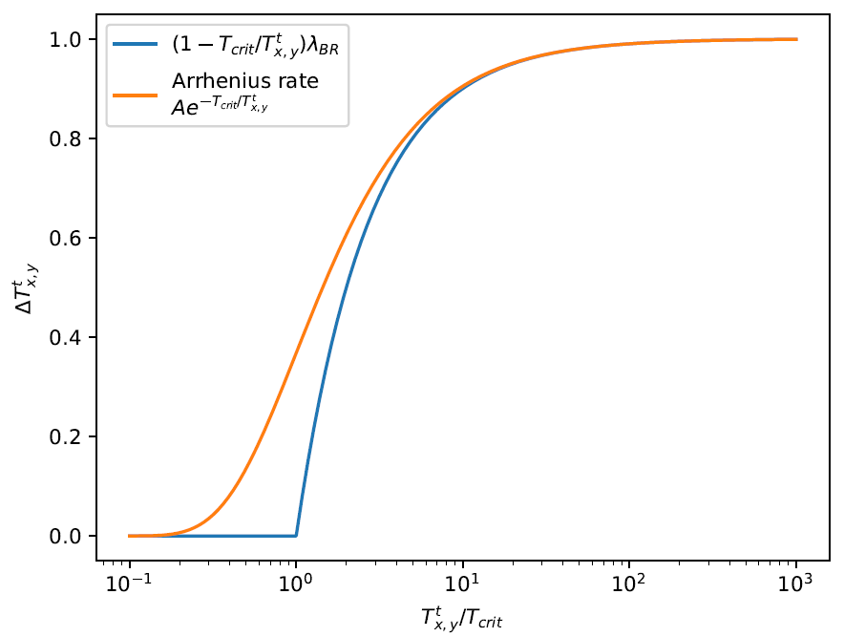
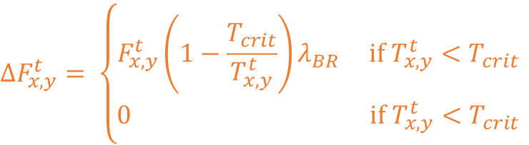
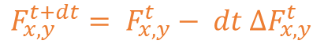

Fuel Field
Fuel should only burn above a certain temperature $T_{crit}$.
Above that, fuel should burn proportional to how high $T$ is compared to $T_{crit}$, and proportional to how much fuel is left to burn.
$$F_{x,y}^{t+dt}= F_{x,y}^{t}− dt ΔF_{x,y}^{t}$$
$$ΔF_{x,y}^{t}= \left\{\begin{aligned}F_{x,y}^{t}\left.\left(1−\frac{T_{crit}}{T_{x,y}^{t}}\right.\right)λ_{BR} \text{if} T_{x,y}^{t}<T_{crit} \\ 0 \text{if} T_{x,y}^{t}<T_{crit}\end{aligned}\right.$$
F-Field
A-Field
W-Field
T-Field
$$α_{atm}$$

Slide 11
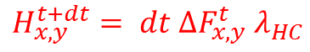
Heat Field
Fuel burned should produce heat. Therefore we define the heat field as the derivative of the fuel field times a constant
$$H_{x,y}^{t+dt}= dt ΔF_{x,y}^{t}{ λ}_{HC}$$
H-Field
Notice that, unlike the T-field and the F-field, the H-field does not depend on the previous state, only on how the F-field changes
F-Field
A-Field
W-Field
T-Field
$$α_{atm}$$

Slide 12
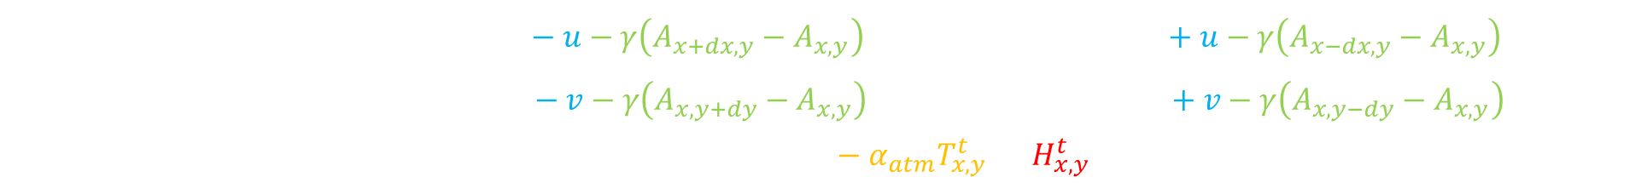
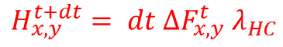

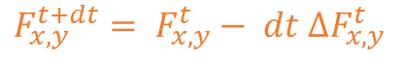
The Model
$$T_{x,y}^{t+dt}= T_{x,y}^{t}+ dt\left(\begin{aligned}α\left(\begin{aligned} T_{x+dx,y}^{t}\left(1−u−γ\left(A_{x+dx,y}−A_{x,y}\right)\right)−2T_{x,y}^{t}+T_{x−dx, y}^{t}\left(1+u−γ\left(A_{x−dx,y}−A_{x,y}\right)\right)+ \\ + &T_{x,y+dy}^{t}\left(1−v−γ\left(A_{x,y+dy}−A_{x,y}\right)\right)−2T_{x,y}^{t}+T_{x,y−dy}^{\left\{t\right\}}\left(1+v−γ\left(A_{x,y−dy}−A_{x,y}\right)\right) \end{aligned}\right)− \\ −&α_{atm}T_{x,y}^{t}+ H_{x,y}^{t}\end{aligned}\right)$$
$$F_{x,y}^{t+dt}= F_{x,y}^{t}− dt ΔF_{x,y}^{t}$$
$$ΔF_{x,y}^{t}= \left\{\begin{aligned}F_{x,y}^{t}\left.\left(1−\frac{T_{crit}}{T_{x,y}^{t}}\right.\right)λ_{BR} \text{if} T_{x,y}^{t}<T_{crit} \\ 0 \text{if} T_{x,y}^{t}<T_{crit}\end{aligned}\right.$$
H-Field
F-Field
A-Field
$$H_{x,y}^{t+dt}= dt ΔF_{x,y}^{t}{ λ}_{HC}$$
W-Field
T-Field
$$α_{atm}$$

Slide 13
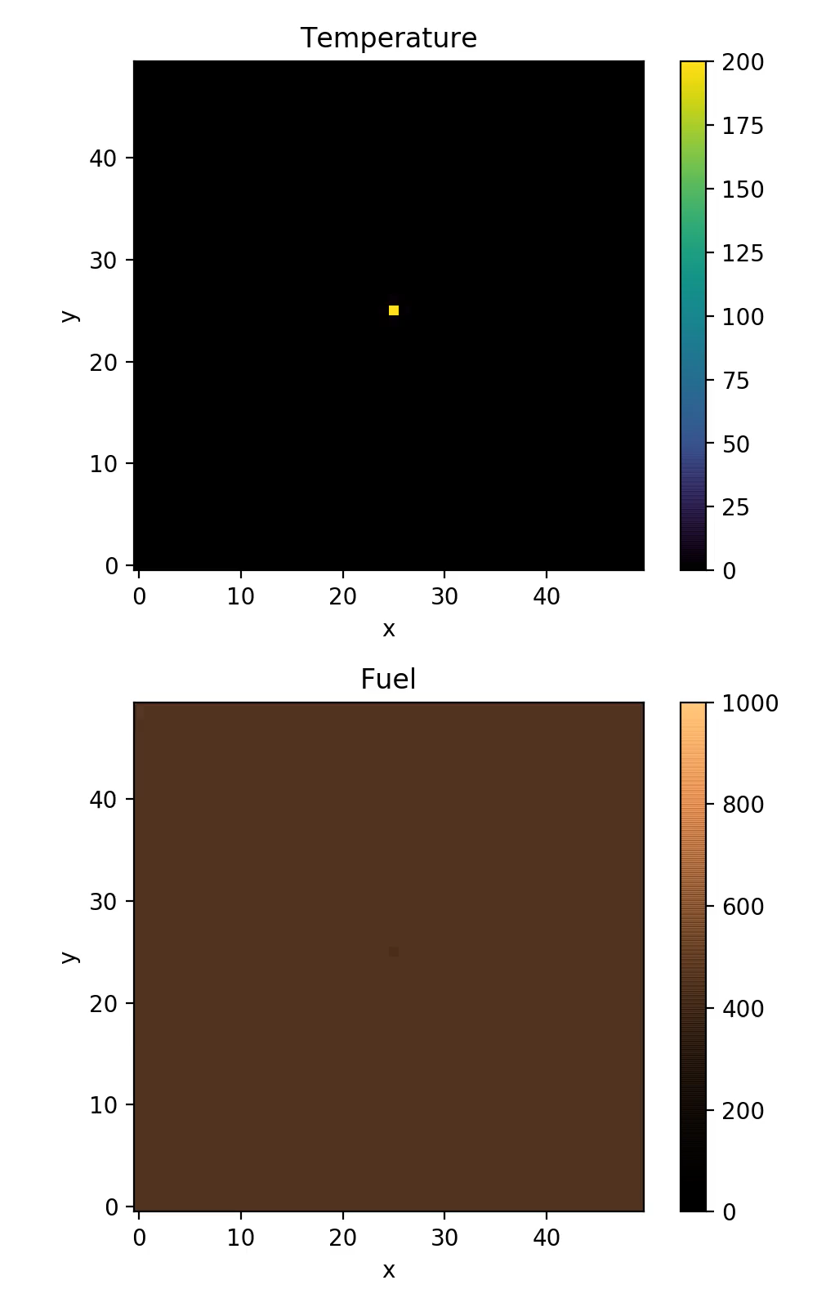
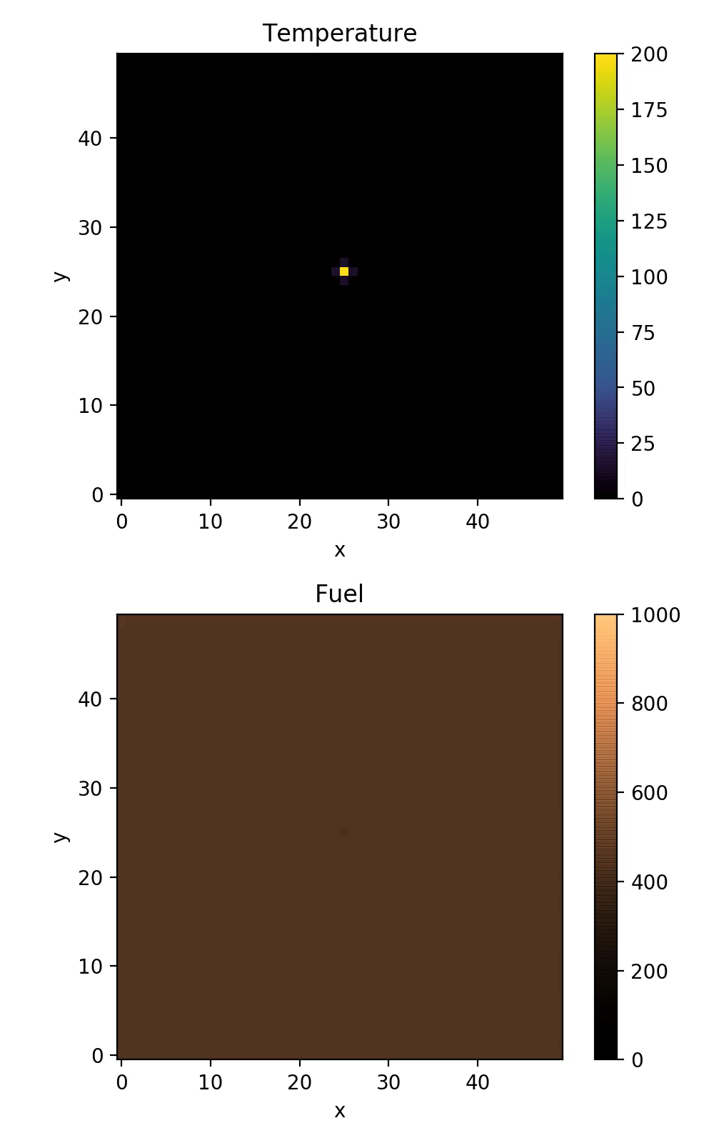










Effect of planar diffusivity
$$α=0.002$$
$α=$ 0.01
$$α=0.03$$
$$α_{atm}=0.004$$
$$λ_{BR}=0.025$$
$$λ_{HC}=175$$
$$γ=0$$
$$T_{crit}=100$$
$$W=(0, 0)$$

Slide 14
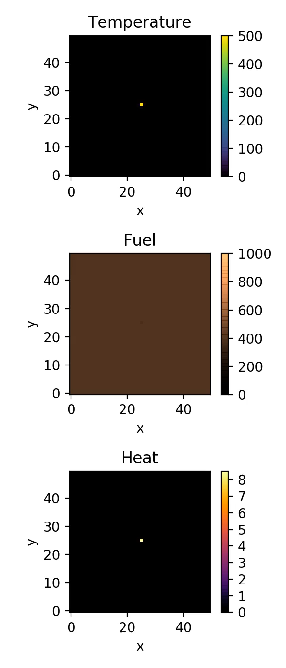











Effect of atmospheric diffusivity
$$α_{atm}=0$$
$$α_{atm}=0.004$$
$α_{atm}=0.00$8
$$α=0.01$$
$$λ_{BR}=0.025$$
$λ_{HC}=17$0
$$γ=0$$
$$T_{crit}=100$$
$$W=(0, 0)$$

Slide 15
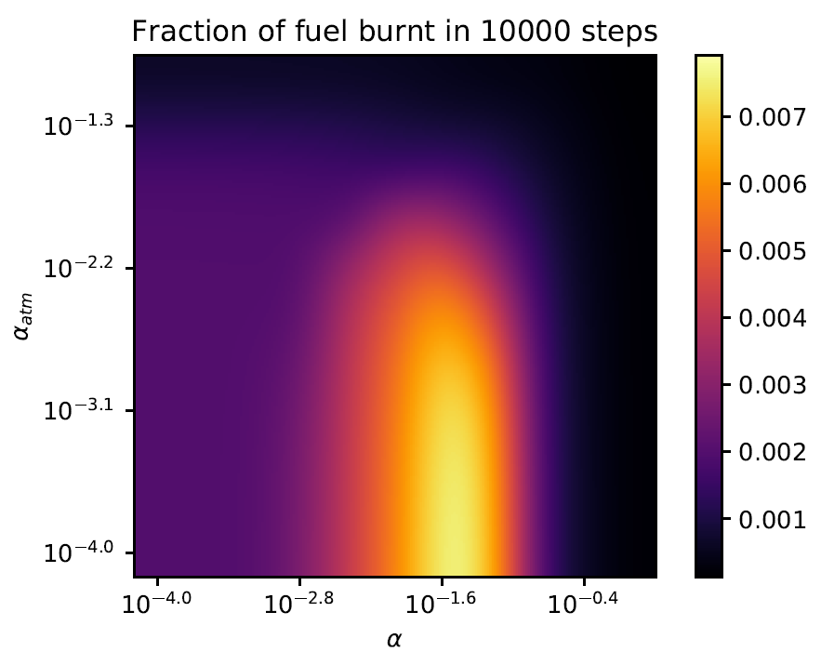





Non-linearity of diffusivity
$$λ_{BR}=0.02$$
$$λ_{HC}=90$$
$$γ=0$$
$$T_{crit}=100$$
$$W=(0, 0)$$

Slide 16
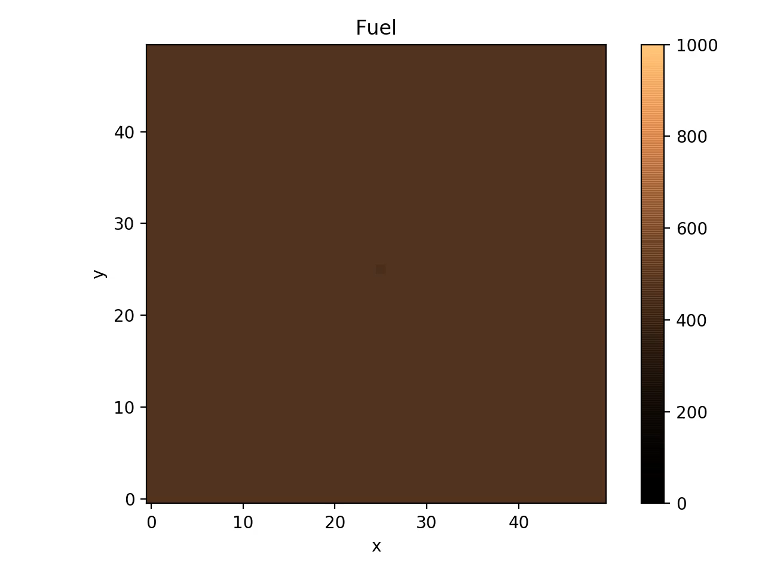











Effect of Wind
$$α=0.005$$
$$γ=0$$
$$α_{atm}=0.004$$
$$T_{crit}=100$$
$λ_{HC}=17$5
$$λ_{BR}=0.025$$
$$W=(0, 0)$$
$$W=(0.1, 0.1)$$
$W=$(0.2, 0.2)
$$W=(0.3, 0.3)$$

Slide 17
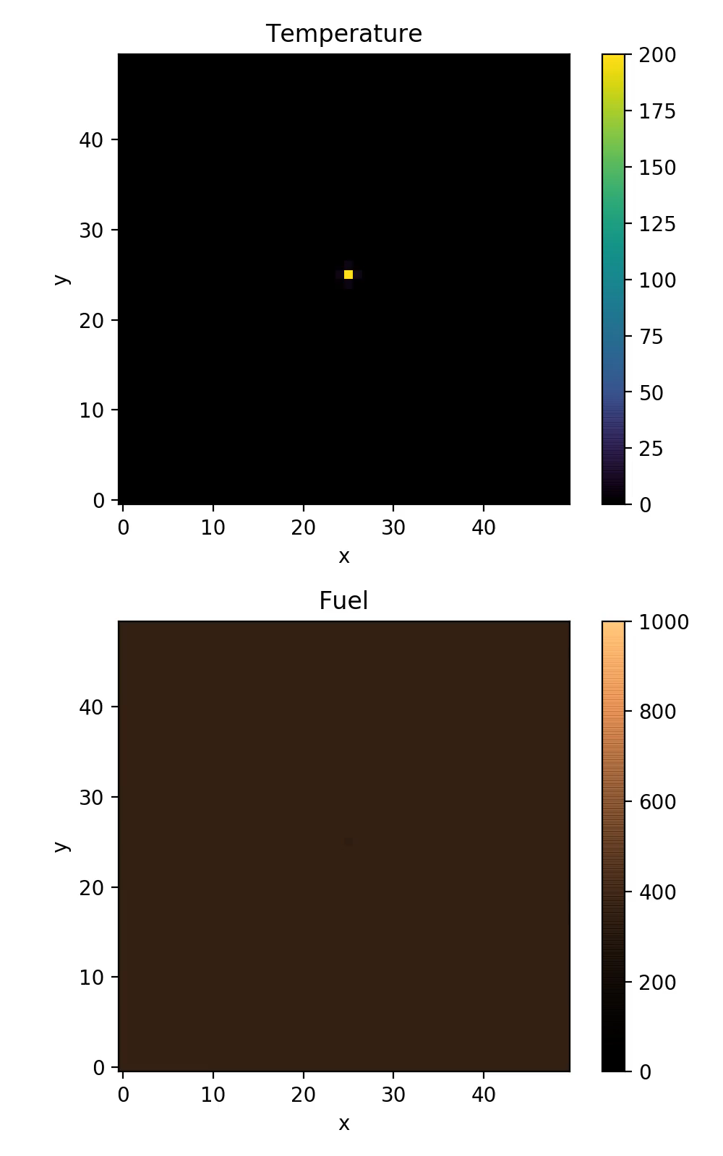

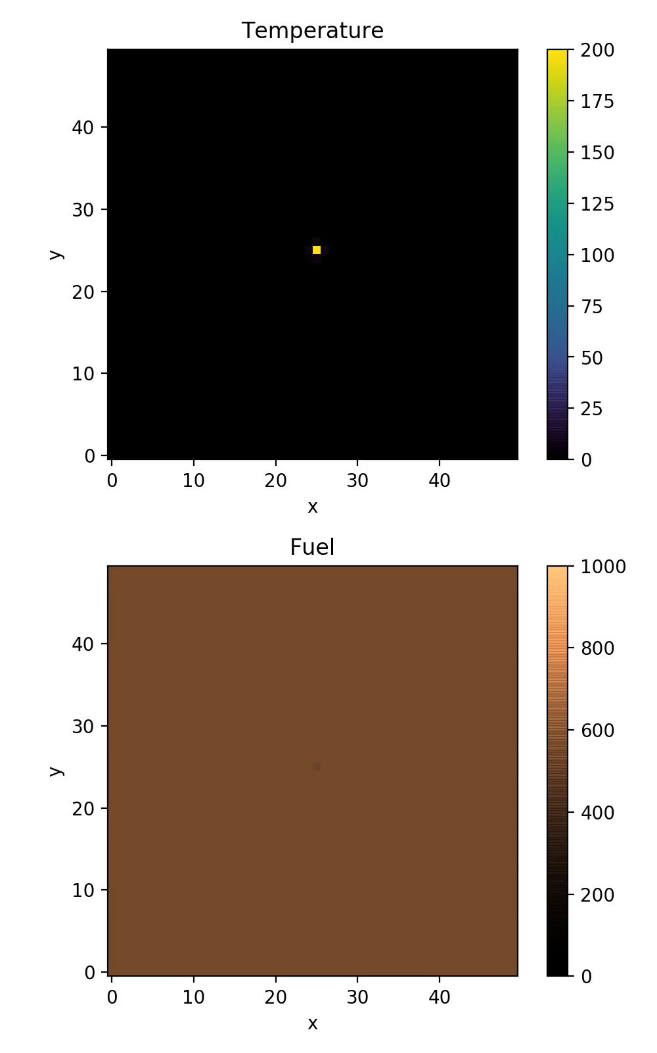









Effect of Fuel Quantity
$$α=0.005$$
$$γ=0$$
$$α_{atm}=0.004$$
$$T_{crit}=100$$
$λ_{HC}=17$5
$$λ_{BR}=0.025$$
$F_{0}=$ 400
$F_{0}=$ 500
$F_{0}=$ 600

Slide 18
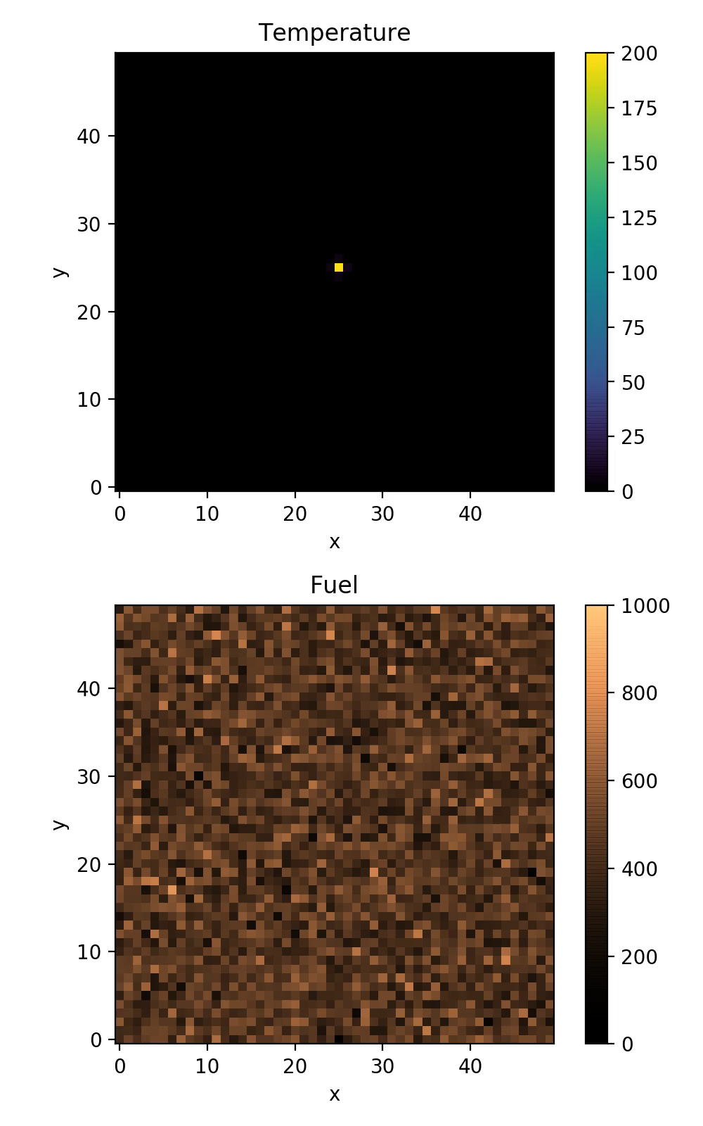
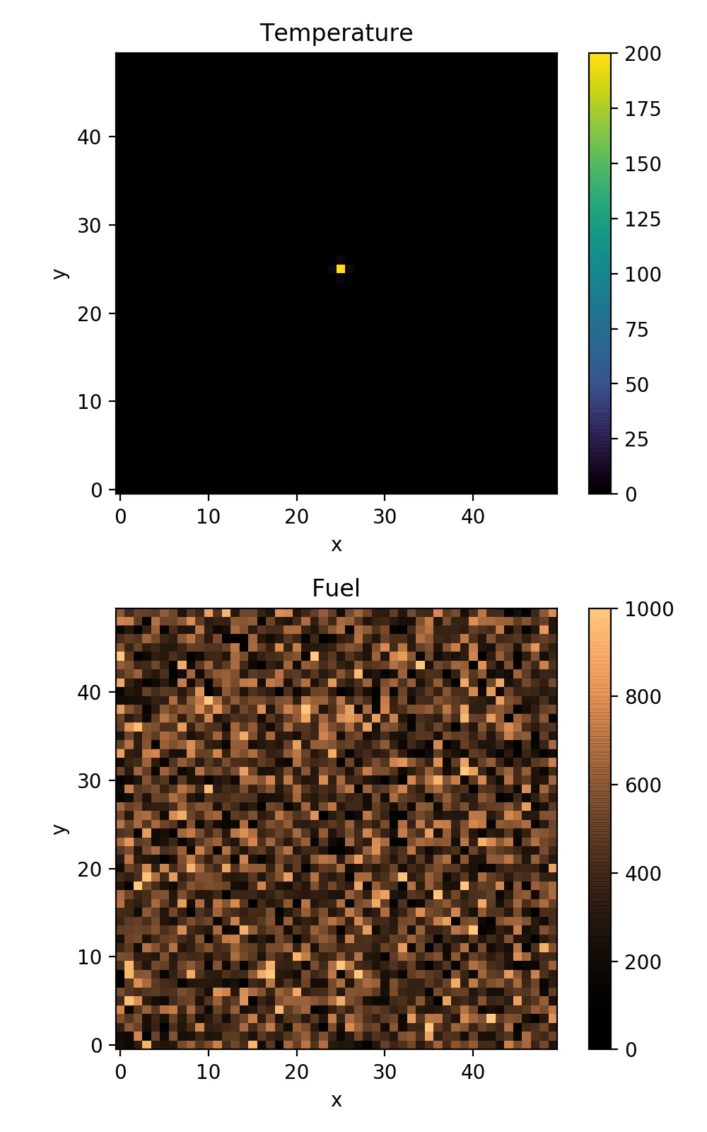










Effect of Fuel Randomization
$$α=0.005$$
$$γ=0$$
$$α_{atm}=0.004$$
$$T_{crit}=100$$
$λ_{HC}=17$5
$$λ_{BR}=0.025$$
$F_{0}=$ 500
$σ_{F_{0}}=$ 0
$σ_{F_{0}}=$ 100
$σ_{F_{0}}=$ 200

Slide 19

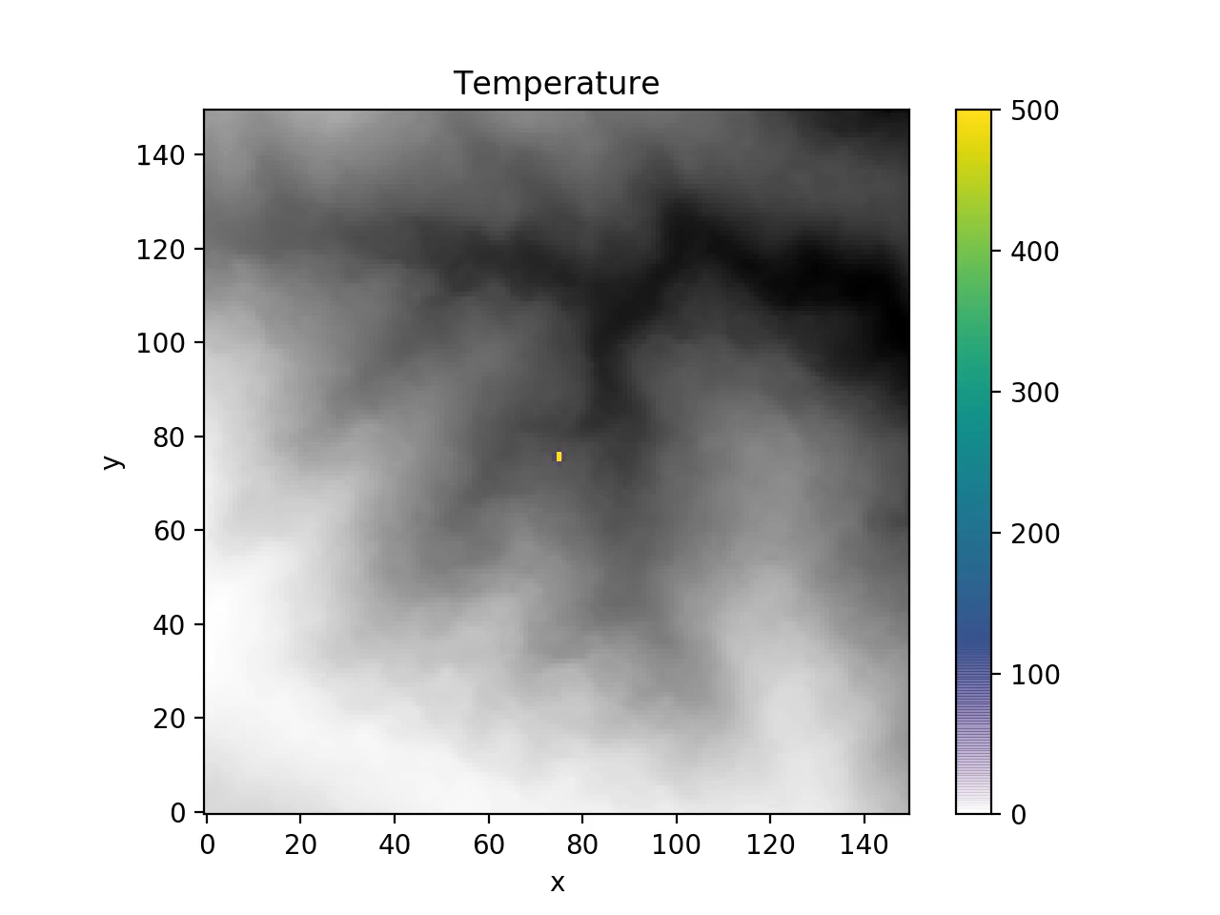

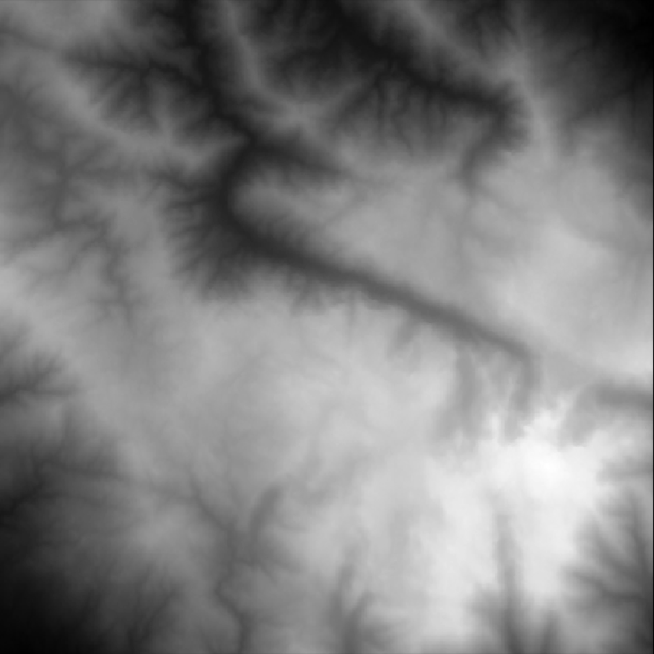
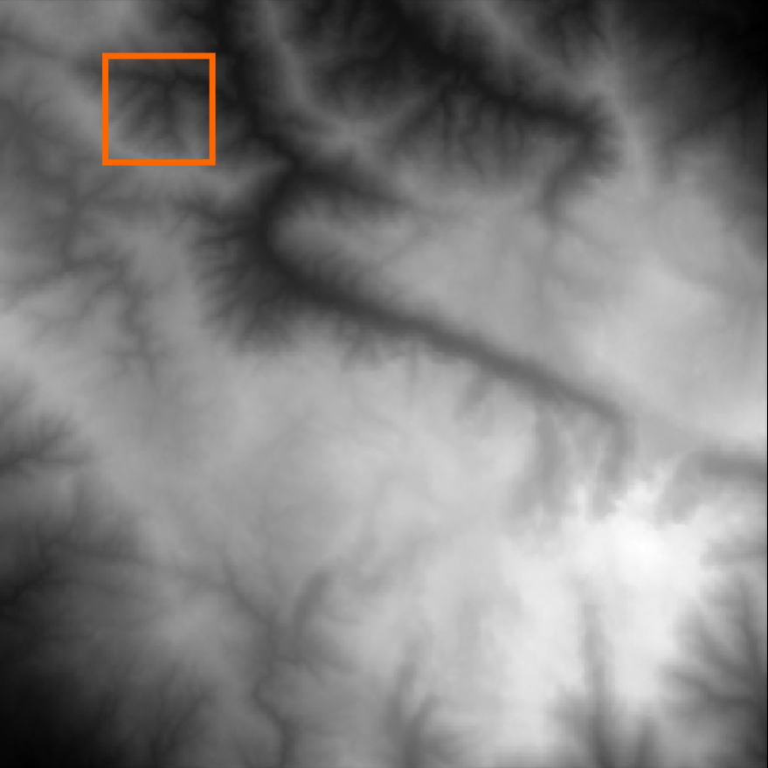
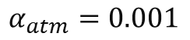
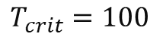
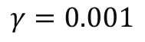
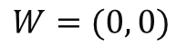
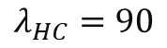
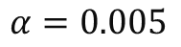
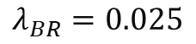
Results with Mountain Height map
$$α=0.005$$
$$α_{atm}=0.001$$
$$W=(0, 0)$$
$$γ=0.001$$
$$T_{crit}=100$$
Height map near the glacier valley in Serra da Estrela
$$λ_{BR}=0.025$$
$$λ_{HC}=90$$

